Slide 1
Tic-Tac-Toe 5x5 Board with Two Consecutive Moves Each
Janaka Jayalal Mohotti Bandara
Shuai Yu
Kate Paparsenou
Foundations of AI (Spring 2025)

Slide 2
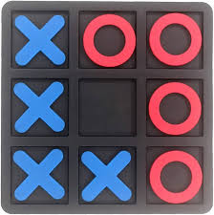
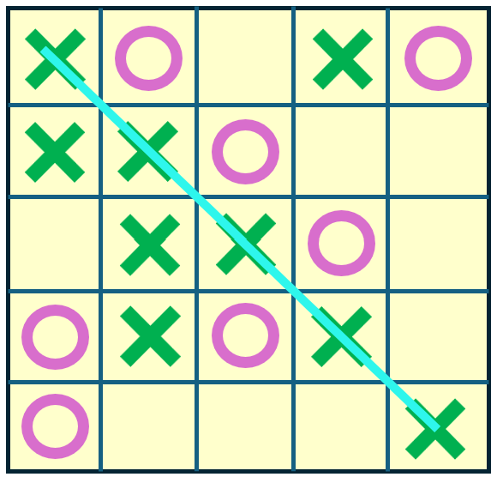
Modified Tic-Tac-Toe
Modified Tic-Tac-Toe game is:
Game board: On a larger 5x5 grid board
Play rules: each player place two marks per turn
Winning condition: align 5 identical marks in a row

Slide 3
Objectives
Apply different types of AI algorithms to play the modified Tic-Tac-Toe game;
Compare the performance of various AI algorithms within reasonable computational timeframes at various evaluation scenarios.

Slide 4
Context and Challenges
State Space Explosion
In a 3×3 board, the theoretical number of possible board states is 3⁹=19683.
In a 5×5 board, the theoretical number of possible board states 3²⁵ ≈ 8.4×10¹¹.
Action Space Expansion (Two Moves per Turn)
This quadratic growth further increases the possible moves significantly.
If there are n empty cells remaining, placing one marks will need evaluate n possible move. While the number of possible action pairs for two moves is n(n−1)/2.
Search Tree Growth
The number of nodes that must be evaluated increases rapidly, making full-depth search computationally infeasible, suitable heuristic functions and strategies are thereby required.

Slide 5
Solution and Contributions
Various Algorithms:
Minimax with Alpha Beta Pruning using a basic heuristic cutoff (MMAB-B)
Minimax with Alpha Beta Pruning using a Monte Carlo heuristic cutoff(MMAB-MC)
Greedy Algorithm
Contributions:
Performance comparison, and how to improve their performance
Relation between the processing time and agent performance
Effect of playing order on the agent winning

Slide 6
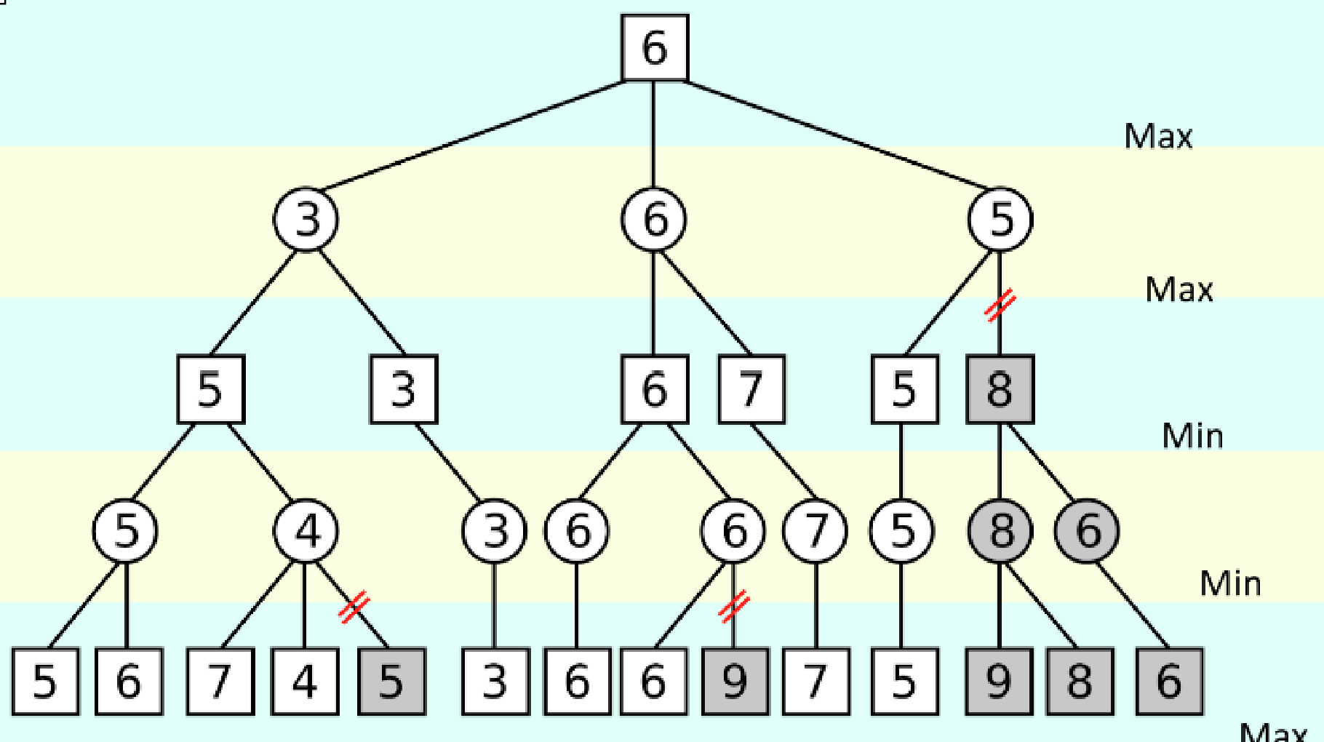
AI Model(s)
MinMax Algorithm
MinMax algorithm navigates through game tree, when it is MAX's turn, the algorithm selects the two moves leading to the highest minimax value, whereas MIN chooses two moves that result in the lowest minimax values.
Main difference of this modified version of the game is this strategic change of the game tree. Game tree becomes min, min, max, max instead of the traditional min max game tree

Slide 7
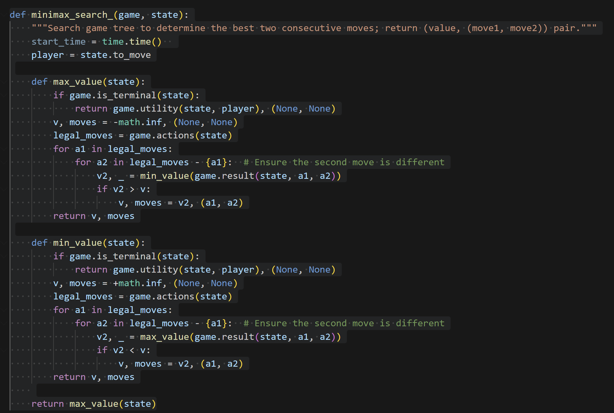

Slide 8
Minimax with Alpha Beta Pruning using a basic heuristic cutoff
truncates the Minimax search early
uses a heuristic evaluation function to approximate a state's utility
evaluates the utility of a non-terminal state with a ‘basic’ heuristic that counts the number of empty squares as a proxy of how close we are to the end of the game
Minimax with Alpha Beta Pruning using a Monte Carlo heuristic cutoff
evaluates the utility of a non-terminal state using Monte Carlo simulation; the idea is to estimate how good a certain game state is by simulating random plays from that state multiple times.
works by repeatedly picking two random legal moves, applying them and updating the game state, until a terminal state is reached or there are fewer than two legal moves.

Slide 9
Greedy Algorithm
designed to find a solution in the shortest possible time by selecting the option that appears most optimal at each step, without considering the overall or future impact of those decisions
selects each step based on a specific evaluation criterion, typically aiming to maximize immediate gain or minimize immediate cost
However, it does not backtrack or consider the broader consequences of each decision, which may lead to suboptimal global results

Slide 10

Discussion of Results
1. Search Algorithm Player vs Random Player
Using a search algorithm consistently has a higher chance of winning
MMAB-MC has the highest win rate at 60%
Draw percentages range from 40% to 80%
Greedy algorithm is the fastest, due to its nature
MMAB-MC is 1.4 times slower than MMAB-B
Worst combination of time complexity and winning outcome is for MMAB-B

Slide 11
Discussion of Results
2. Random Player vs Search Algorithm Player
Same results for both MMAB-B and MMAB-MC
Greedy: 0% chance of winning, with all the games ending in draw
Greedy is the fastest, as expected
The time needed is shorter when the Search Algorithm plays second, as expected
First mover advantage for Greedy

Slide 12
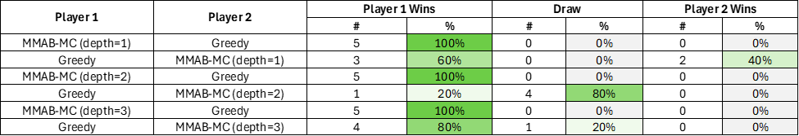
Discussion of Results
3. MMAB-MC Player vs Greedy Player
Expectation that as the depth increases for the search algorithm, the chance to win also increases
Potentially low number of total games (ie. 5)
First mover advantage insight for Greedy confirmed

Slide 13
Conclusion
Performance Comparison:
MMAB-MC performed best
Relation between processing time and performance:
MMAB-MC is the slowest, Greedy is the fastest
processing time decreases substantially, when AI agents played second
Effect of Search Depth: small number of games simulated to get concrete results
Impact of Player Order: when the Greedy algorithm moved first, it had a higher winning rate

Slide 14
Thank you

